Slide 1
Basic Electrical and Electronics Engineering
LECTURE 3.2
Dr. Sonam Shrivastava/ Assistant Professor (Sr.) /SELECT

Slide 2
BEEE102L
Basic Electrical and Electronics Engineering
DC Circuits
AC Circuits
Magnetic Circuits
Electrical Machines
Semiconductor Devices and Applications
Digital Systems

Slide 3
Books
Text Books
Allan R. Hambley, “Electrical Engineering -Principles & Applications”, 2019, 6th Edition, Pearson Education
V. D. Toro, Electrical Engineering Fundamentals, 2nd edition. PHI, 2014
Reference Books
R. L. Boylestad and L. Nashelsky, Electronic Devices and Circuit Theory, 11th edition. Pearson, 2012
DP Kothari & Nagrath, “Basic Electric Engineering”, 2019, Tata McGraw Hill

Slide 4
Module 3. Magnetic Circuits
Magnetic field; Toroidal core: Flux density, Flux linkage;
Magnetic circuit with air gap;
Reluctance in series and parallel circuits;
Electromagnetic Induction: Self And Mutual
Magnetically Coupled Circuits
Series and Parallel Magnetic Circuits
Dot Convention

Slide 5
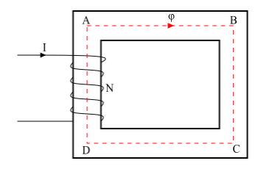
MAGNETIC CIRCUITS
A magnetic circuit is defined as a closed path followed by the magnetic flux.
Consider a coil of N turns wound on an iron core (see the figure).
When an electric current I is passes through the coil, magnetic flux (ψ) is set up in the core.
This magnetic flux follows a closed path ABCDA and hence ABCDA is the magnetic circuit.
In a magnetic circuit, the amount of magnetic flux in the core depends upon the current (I) and the number of turns (N).
The product NI is known as the Magneto motive Force (MMF).
MMF=NI=Ampere−Turns
The opposition offered by the magnetic circuit to the flow of magnetic flux is known as reluctance (S) of the magnetic circuit.

Slide 6
MAGNETIC CIRCUITS
Series Magnetic circuit
Simple magnetic circuit
Composite magnetic circuit
Parallel Magnetic circuit
Series and parallel magnetic circuit

Slide 7
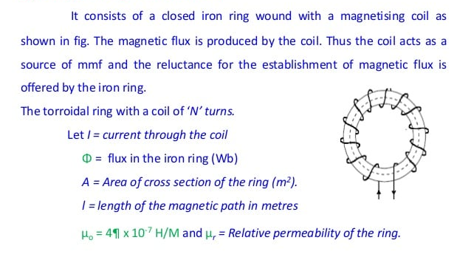
Simple SERIES MAGNETIC CIRCUITS

Slide 8
Simple SERIES MAGNETIC CIRCUITS

Slide 9
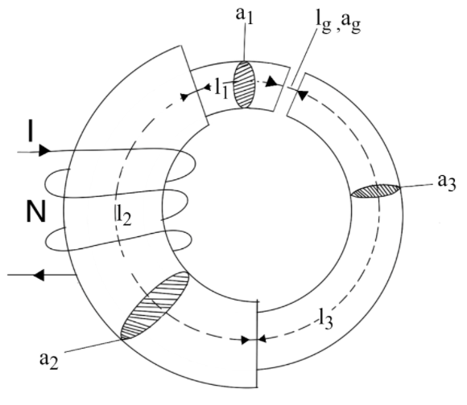
Composite series magnetic circuits
When the same magnetic flux ψ flows through each part of the magnetic circuit, then the circuit is called as series magnetic circuit.
Consider a composite series magnetic circuit (a series magnetic circuit that has parts of different dimensions and materials is called a composite series magnetic circuit) consisting of three different magnetic materials of different relative permeability.
Each part of this series magnetic circuit will offer reluctance to the magnetic flux ψ. Since the different parts of the magnetic circuit are in series, the total reluctance is equal to the sum of reluctances of individual parts.

Slide 10
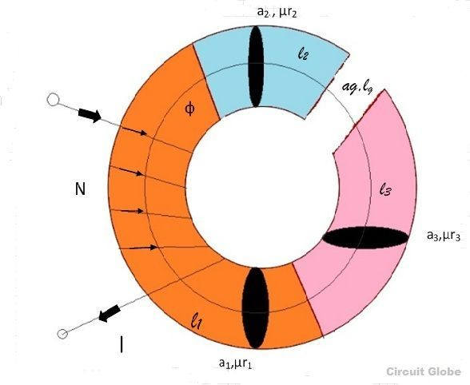
Composite series magnetic circuits
Current I is passed through the solenoid having N number of turns wound on the one section of the circular coil. Φ is the flux, set up in the core of the coil.
Cross-sectional area of the solenoids= a₁, a₂, a₃
Length of the three different coils having different dimension joined together in series= l₁, l₂, l₃
Relative permeability of the material of the circular coils= µr₁, µr₂, µr₃ .
a_{g} =Area of the air gap
lg =Length of the air gap.

Slide 11
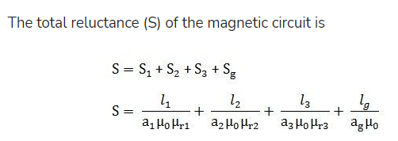
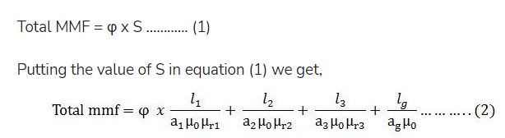
Composite series magnetic circuits

Slide 12
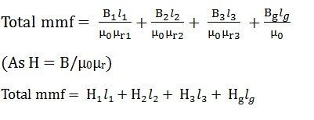
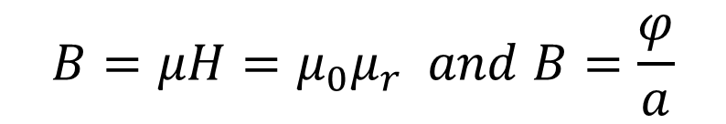
Composite series magnetic circuits
$$B=μH=μ_{0}μ_{r} and B=\frac{φ}{a}$$
Using
in eq 2

Slide 13
Problem 1. A magnetic circuit consists of an iron ring of mean circumference 80 cm with cross-sectional area of 12 cm² throughout. A current 0f 2A in the magnetising coil of 200 turns produces a total flux of 1.2 mwb in the iron. Calculate :
(i) the flux density in the iron
(ii) the absolute and relative permeability's of iron.
(iii) the reluctance of the circuit.

Slide 14



Problem 1. A magnetic circuit consists of an iron ring of mean circumference 80 cm with cross-sectional area of 12 cm² throughout. A current 0f 2A in the magnetising coil of 200 turns produces a total flux of 1.2 mwb in the iron. Calculate :
(i) the flux density in the iron
(ii) the absolute and relative permeability's of iron.
(iii) the reluctance of the circuit.
B=1 wb/m2
$$μ=0.002$$
$$μ_{r}=1591.5$$
$S={3.33×10}^{5}$AT/Wb

Slide 15
Problem 1. A magnetic circuit consists of an iron ring of mean circumference 80 cm with cross-sectional area of 12 cm² throughout. A current 0f 2A in the magnetising coil of 200 turns produces a total flux of 1.2 mwb in the iron. Calculate :
(i) the flux density in the iron
(ii) the absolute and relative permeability's of iron.
(iii) the reluctance of the circuit.
B=1 wb/m2
$$μ=0.002$$
$$μ_{r}=1591.5$$
$S={3.33×10}^{5}$AT/Wb

